Slide 1

Calotracker @ whizkraft.in
- Yeshwantrao Naik

Slide 2
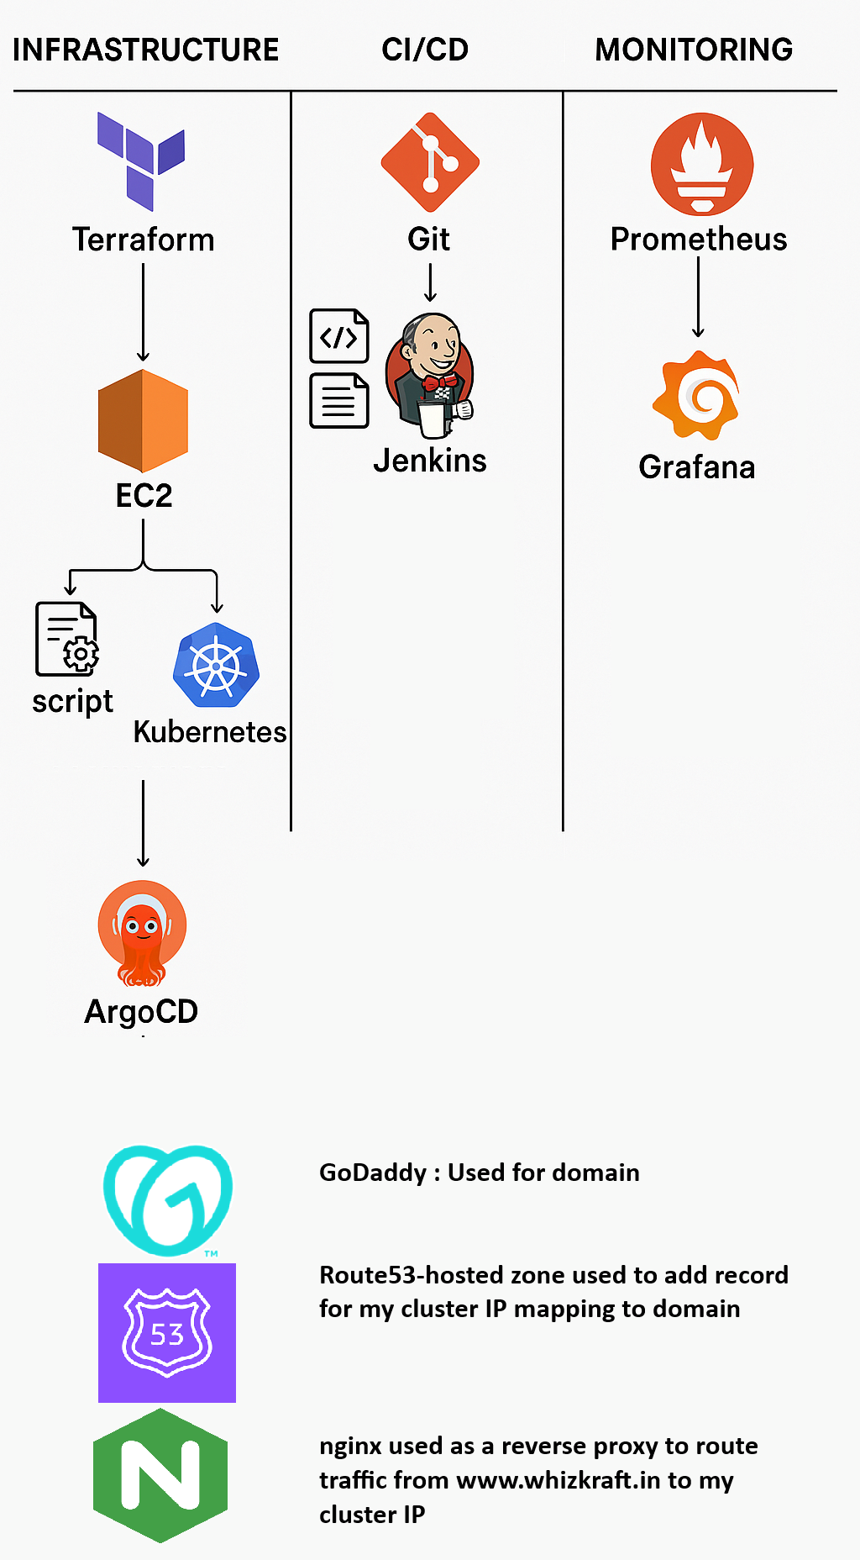
Tech Stacks

Slide 3
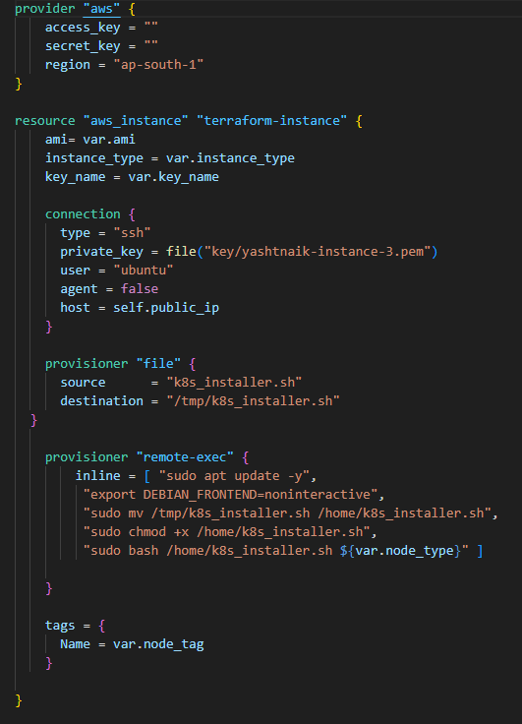
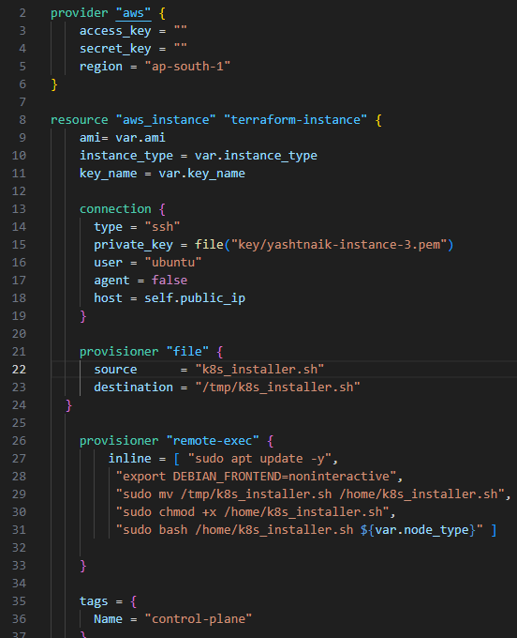
Infrastructure & Cluster Setup
Terraform was used to provision AWS EC2 instances. Using file and remote-exec provisioners, it executed a shell script that installed the Kubernetes components (kubeadm, kubelet, kubectl, containerD) and configured the networking solution (Calico). Terraform variables were used to differentiate and configure the control plane and worker nodes.
Kubernetes Cluster consisting 1 control plane and 1 worker node was setup.

Slide 4
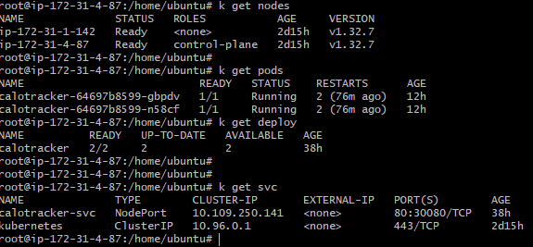
Kubernetes Cluster | Deployment, SVC, Pods, Nodes

Slide 5
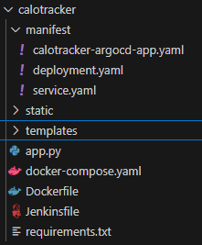
CI/CD
A Git repository is used to store the application's source code along with Kubernetes manifest files, including Deployment, Service, and ArgoCD Application configurations.
Jenkins CI/CD Pipeline Flow
Stage-1: Checkout Code Jenkins pulls the latest code from the Git repository, which includes: Application source code Kubernetes manifest files (e.g., deployment.yaml, service.yaml, argocd-app.yaml)
Stage-2: Build Docker Image Jenkins uses a Dockerfile to build the application image.
Stage-3: Push to Docker Hub The built image is tagged and pushed to a Docker Hub repository (e.g., yashtnaik/calotracker:v1).
Stage-4: Update Kubernetes Deployment Manifest Jenkins updates the deployment.yaml file to reference the new image tag. Push Updated Manifest to Git Repository The modified deployment.yaml is committed and pushed back to the Git repository.
ArgoCD Sync ArgoCD detects the change in the Git repo and automatically syncs the updated manifests to the Kubernetes cluster. Important links: 1. Git Repo: https://github.com/yashtnaik/calotracker.git 2. DockerHub image repo: yashtnaik/calotracker:v1

Slide 6
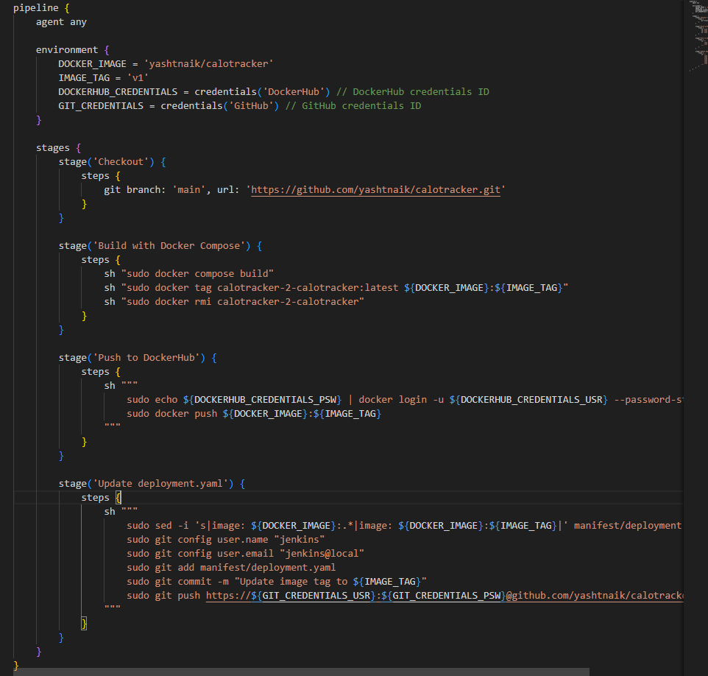
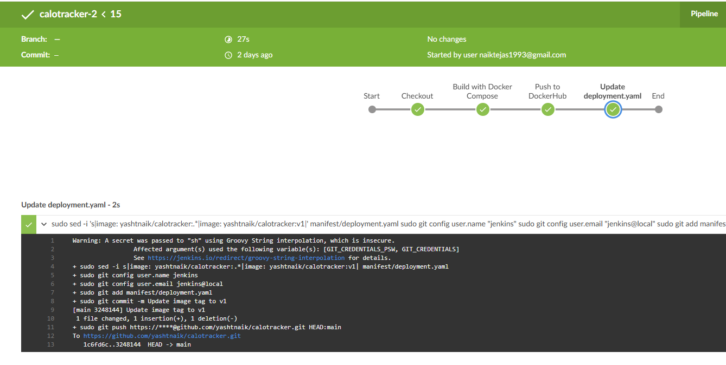
Jenkins Pipeline

Slide 7
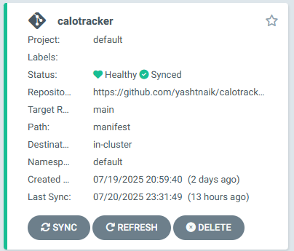
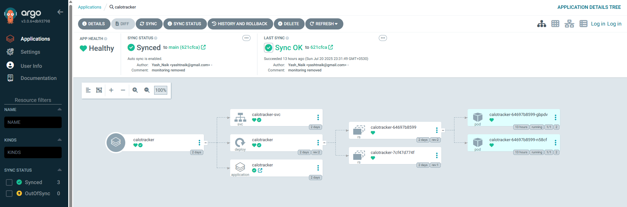
ArgoCD Application for Visualizing

Slide 8
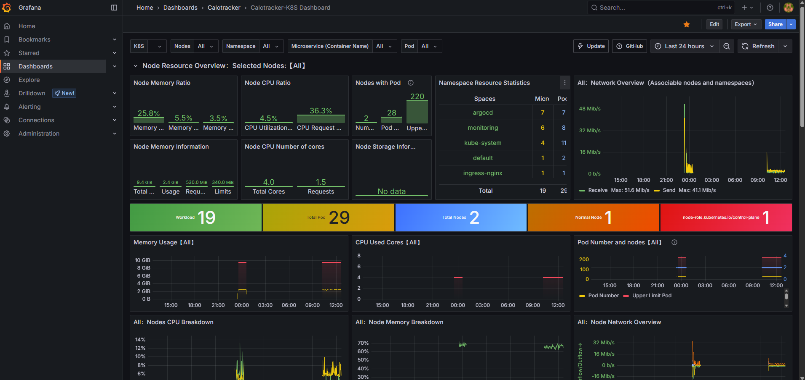
Monitoring | Prometheus-Grafana
CAdvisor & Exporters deployed in cluster as DaemonSet.
Prometehus used as monitoring and alerting system that scrapes metrics from data exporters.
Grafana used for visualization.

Slide 9
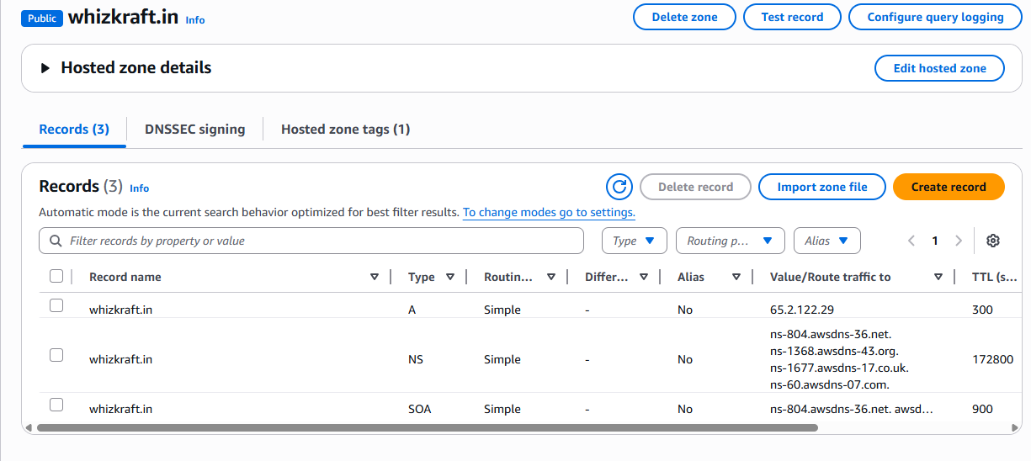
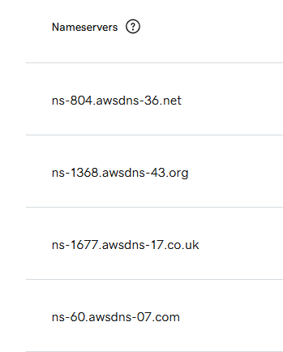
Route53-Hosted-Zone-Record
The domain whizkraft.in was purchased from GoDaddy.
DNS management was shifted to AWS Route 53 by updating the domain's nameservers in GoDaddy to point to Route 53.
An A record was created in Route 53 to map whizkraft.in to the public IP of the server hosting the cluster.
Nginx was configured as a reverse proxy to route incoming traffic from whizkraft.in to the Kubernetes service (NodePort).

Slide 10
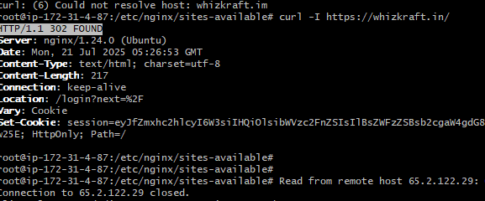
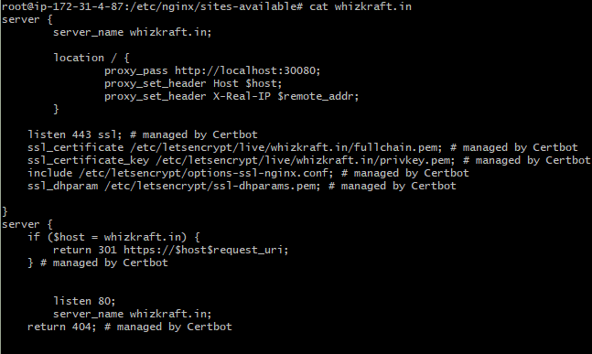
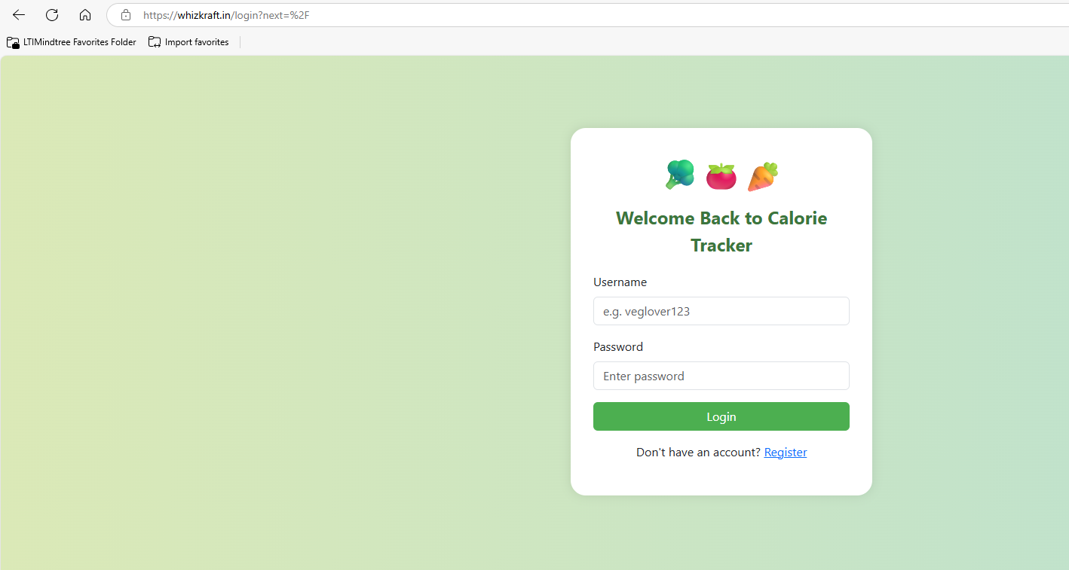
Nginx-Reverse Proxy configuration & DNS Resolution
https://whizkraft.in/

Slide 11
Scope of improvement
1. Security Enhancements
Implement RBAC and Pod Security Policies.
Use Security Contexts and Network Policies to restrict access.
Enable TLS encryption for internal and external traffic.
Secure CI/CD pipeline with secrets management (HashiCorp Vault).
2. Observability: Logging & Tracing
Integrate centralized logging using ELK Stack.
Implement distributed tracing with Jaeger.
3. Application Metrics & KPIs
Expose custom application metrics.
Define and monitor KPIs like request latency, error rates, and throughput.
4. Networking Improvements
Replace NodePort with LoadBalancer or Ingress Controller for better scalability.
Use Ingress Resources with TLS and path-based routing.
5. Application Architecture
Refactor into a 3-tier architecture.
Use microservices for scalability and maintainability.
Have branching strategy for Dev, QA, Pre-Pod, Prod & Hotfix.
6. Disaster Recovery & Maintenance
Implement backup strategies for etcd, persistent volumes, and databases.
cluster maintenance
7. CI/CD Quality & Security
Integrate SonarQube for code quality analysis.
Use Trivy for container image vulnerability scanning.
Enforce pre-deployment checks in pipeline stage.
8. High Availability Infrastructure
Use multi-AZ deployments for critical components.
Deploy HA control plane and replicated etcd.
Use auto-scaling for workloads and infrastructure.
9. Terraform State Management
Store Terraform state remotely using S3 backend.
Enable state locking using DynamoDB to prevent concurrent modifications.

Slide 12

Thank You!

